Slide 1
Used Cars Price Prediction: Using Machine Learning
Nishan Karki
Mississippi State University
The main aim of this project is to explore the dataset and discuss some interesting observations through visualizations and train machine learning models to fit and predict the prices of the used cars based on various features using supervised learning.

Slide 2
Background
Cars are an essential medium of transportation for people all around the world.. They are sold either brand new or used. The cost of new cars is rapidly increasing every year, so the used cars sale market is rising which is comforting for people earning low wages.
An article published in CNBC states that the used car market in the U.S. is already estimated at 41 million units annually, some of the changes triggered by the covid-19 pandemic will continue to accelerate. This shows that the Americans want to their own vehicles for many reasons and car sales industry is one of the biggest industries in the USA.
However, there are some problems in the used cars sale sector. Some car sellers are selling the used cars above the real price to the customers who are not aware of car prices in general.
People with little or no knowledge about car prices are paying more than the real price of used cars due to several trick plays by dealerships and private sellers.

Slide 3
Motivation
My first was a used car which I had purchased from a private seller in Texas. I purchased 2012 Honda Accord Sedan for $13000 plus tax with 90,000 miles on it.
It was a salvaged title car. I had no idea about title of the car such as clean, salvage, or rebuild at the time of purchase. After few weeks, I realized it was worth less than $10,000.
I felt like I was cheated on the deal as I could not do anything about it. At that point of time, I was really interested in knowing about cars and their sales in brief.
I wanted to build an efficient used cars price prediction model based on many features like year of manufacture, miles driven, cylinder type, title status, brand etc to help people buying and selling used cars in a fair deal.

Slide 4
Used Cars Dataset
Downloaded from Kaggle provide by Austin Reese.
Link to the dataset: https://www.kaggle.com/austinreese/craigslist-carstrucks-data
Size of dataset: 458,213 rows and 26 columns.

Slide 5
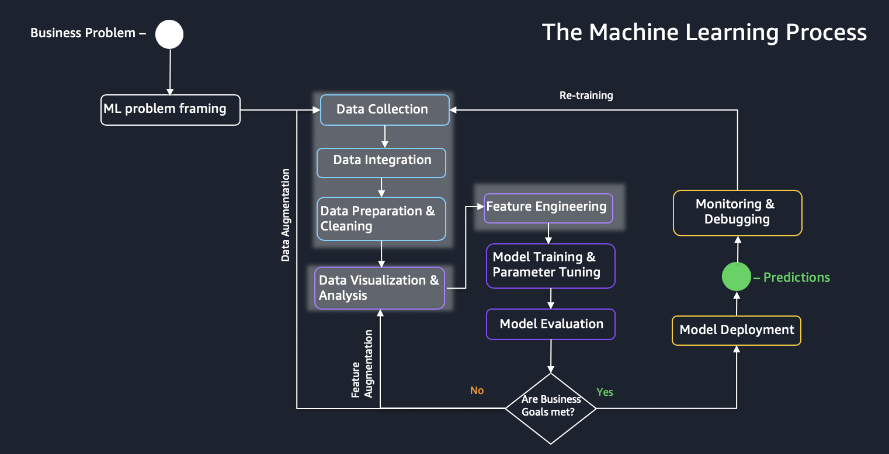
ML Project Life Cycle

Slide 6
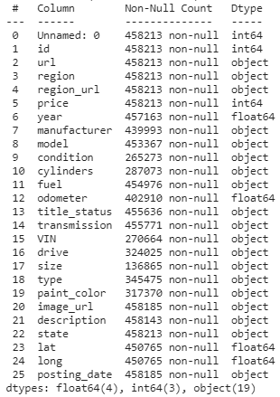
Loading the dataset
Loading the dataset into using pandas.

Slide 7
Data Analysis: Listing Numerical and Categorical features
Categorical Features
'url', 'region', 'region_url', 'manufacturer', 'model', 'condition', 'cylinders', 'fuel', 'title_status', 'transmission', 'VIN', 'drive', 'size', 'type', 'paint_color', 'image_url', 'description', 'state', 'posting_date’
Numerical Features
‘id’, ‘price’, ‘year’, ‘odometer’, ‘lat’, ‘long’

Slide 8
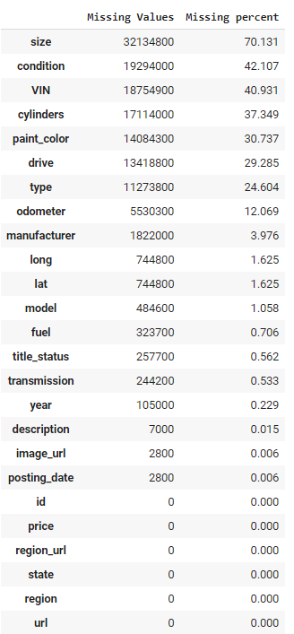
Data Analysis: Missing Values

Slide 9
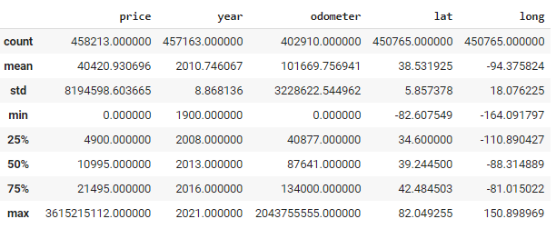
Data Analysis
There are about 460,000 record in the dataset.
There are unreal prices for the cars in the dataset, the minimum price is $0, and the maximum price is 3.6 billion dollars. Since, nobody sells cars for free nor there is a car worth 3.6 billion. The most expensive cars like Bugatti, Pagani, Koenigsegg, Ferrari are worth millions not billions. These outliers must be removed from the price column.
The maximum odometer reading is more than 2 billion miles. No car runs billion miles. There are visible outliers in odometer column, which must be handled as well.

Slide 10
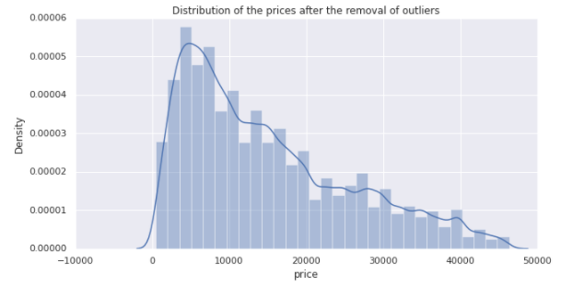
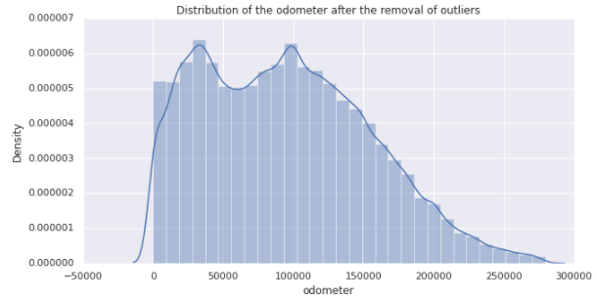
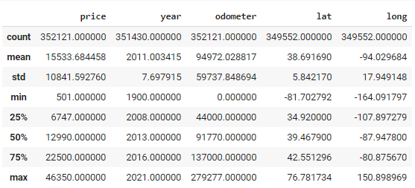
Data Cleaning: Removing Outliers from price and odometer column

Slide 11
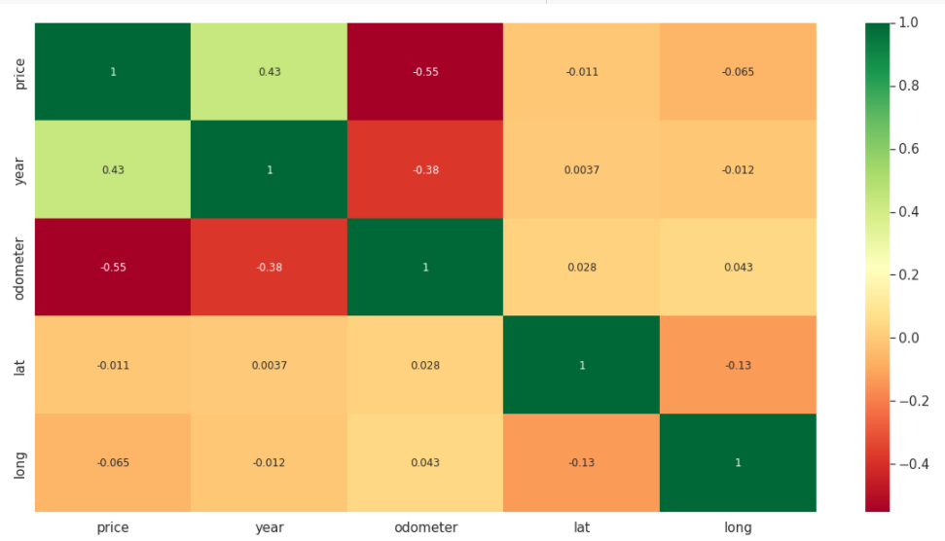
Correlation between numerical features: lat and long columns are dropped due to low correlation with price

Slide 12
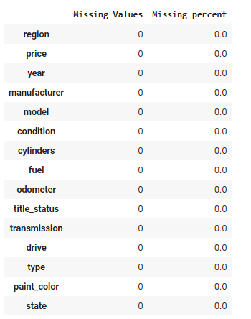
Data Cleaning: Handling Missing Values and removing unnecessary columns
There are many missing values in our dataset, and these missing values must be handled very carefully. The following three actions must be performed:
The column 'size’ had 68.439% data missing. That's a significant number of missing values. So, we drop the entire 'size' column.
We remove the corresponding rows from the features that have very few missing values i.e., "year", "manufacturer", "model", "fuel", "transmission", "drive", "type", "paint_color" features.
For features: "condition" and "cylinders", we assign the missing values with another unique category called "null".
Also, there were many categorical variables like ['url',,'id','posting_date','image_url','description', 'region_url', 'VIN’] with no meaning or contributing too less to the target variable (price) are removed from the dataset.

Slide 13
Data Visualization

Slide 14
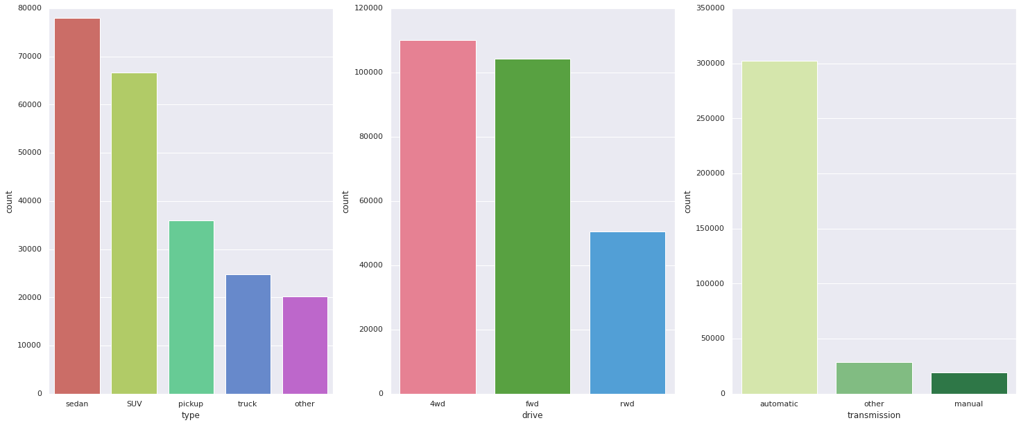
Count plot of vehicle type, drive, and transmission

Slide 15
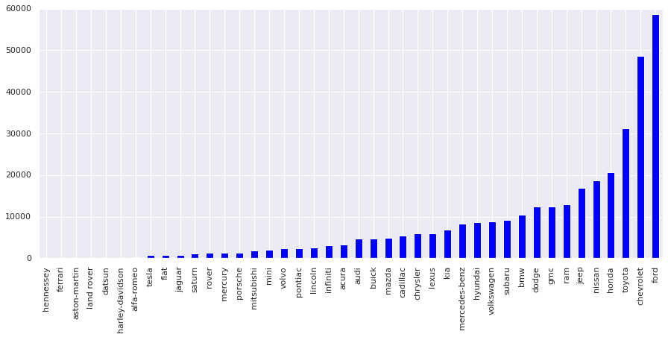
Top manufacturers in USA

Slide 16
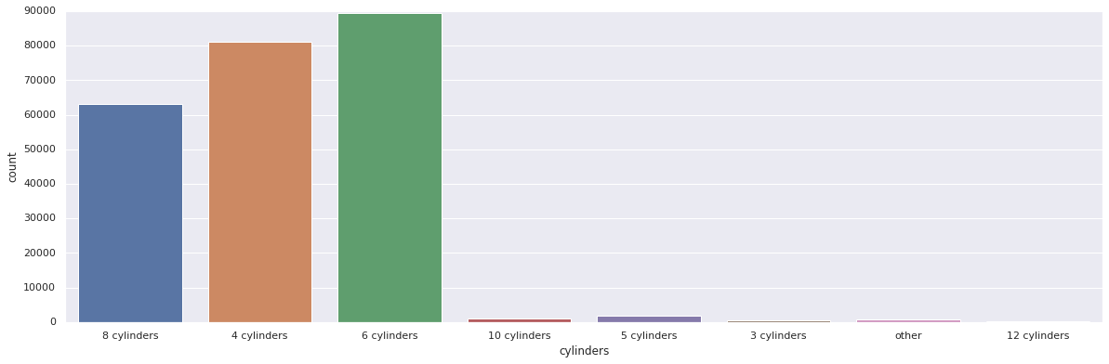
Total count of cylinder types

Slide 17
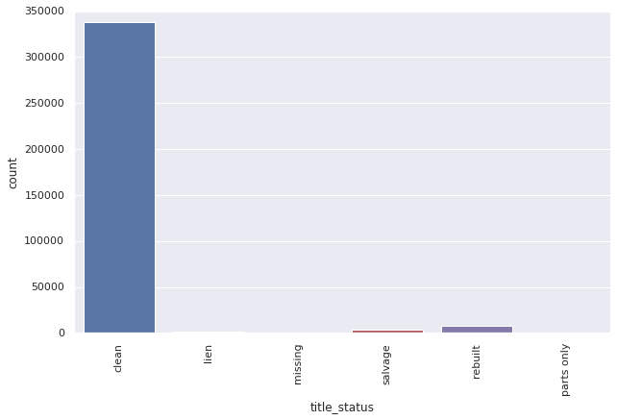
Count Plot of Title Status

Slide 18
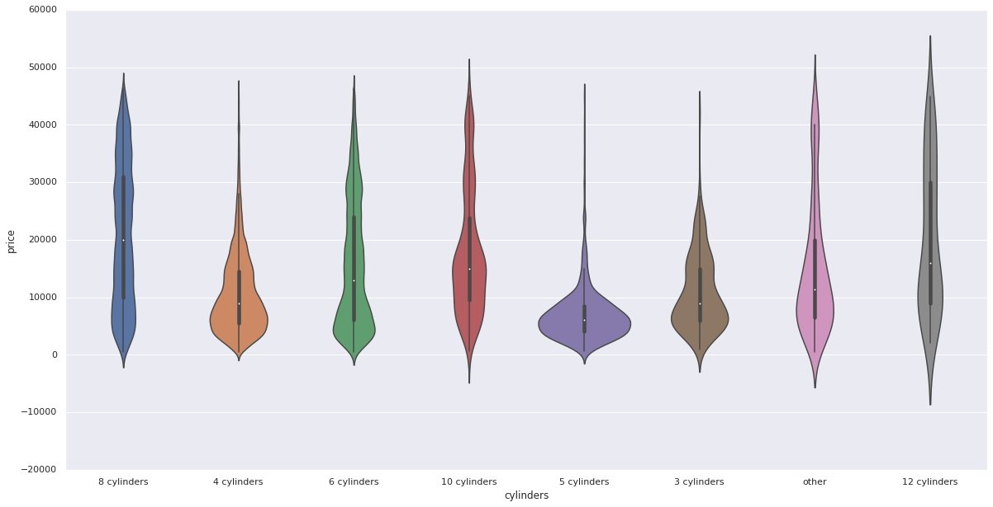
Price vs Cylinder Types

Slide 19
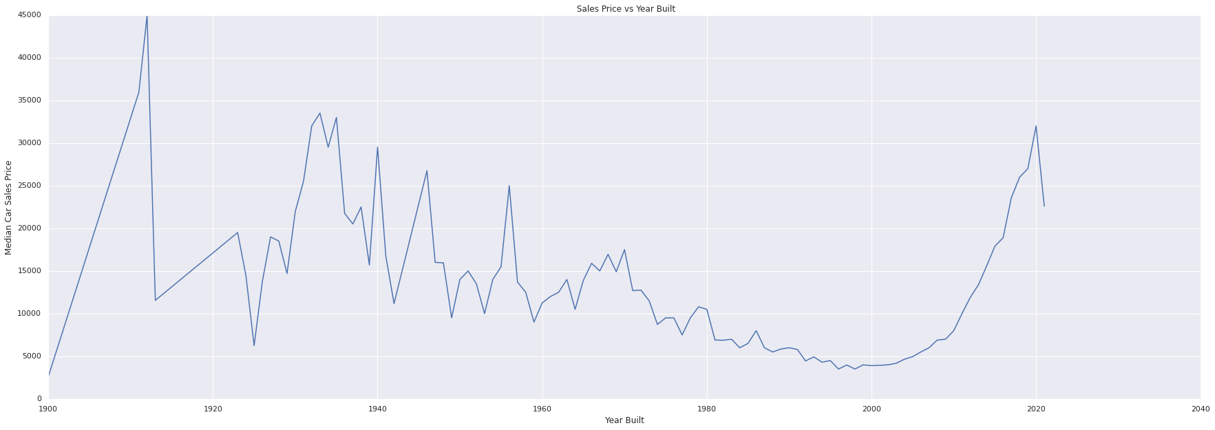
Median price of cars vs Year Built

Slide 20
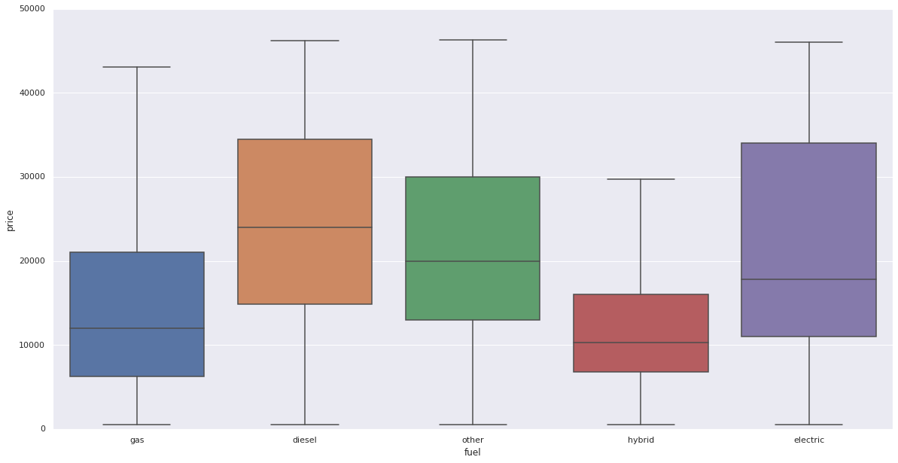
Price vs Fuel type

Slide 21
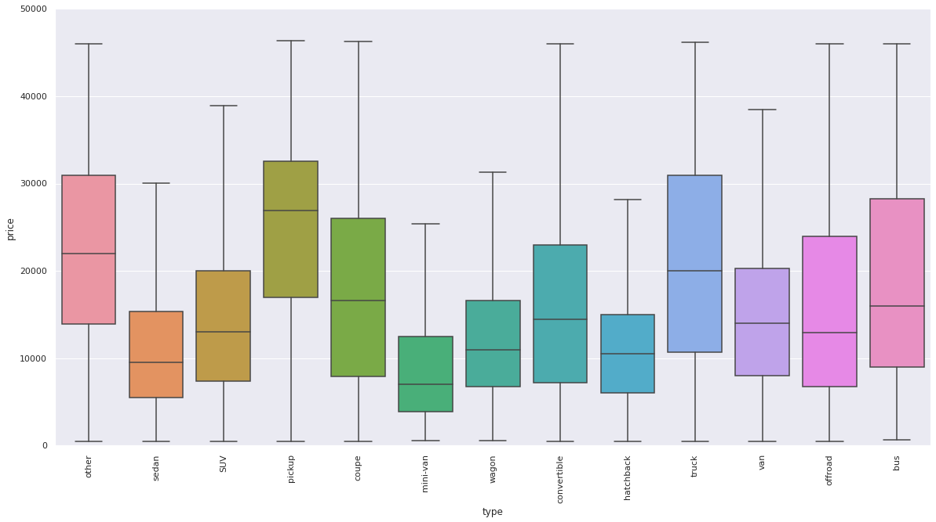
Price vs Vehicle Types

Slide 22
Encoding Categorical Features
Encoding helps to transform categorical variables into a numerical form so that ML algorithms can learn from it.
We have 10 categorical features out of 13.
condition and cylinders are ordinal features
All other are nominal features
Dropping model column from the dataset as it has way too many categories and do not correlate well with price.

Slide 23
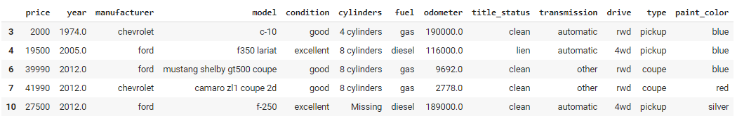
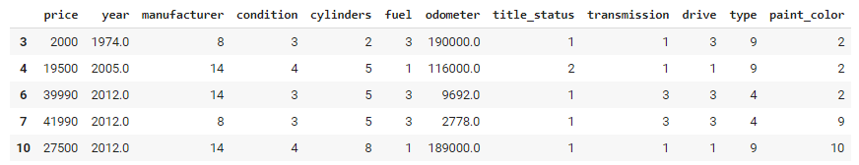
Encoding Categorical Features

Slide 24
Feature Scaling: Normalization or Standardization
Feature Scaling is the process of bringing back the values to a particular range.
Normalization is good to use when we know that the distribution of data does not follow a Gaussian distribution. It typically rescales the values into a range of [0,1]
Standardization, can be helpful in cases where the data follows a Gaussian distribution. It typically rescales data to have a mean of 0 and a standard deviation of 1.

Slide 25
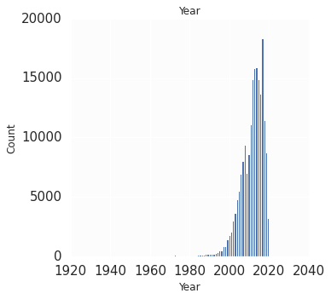
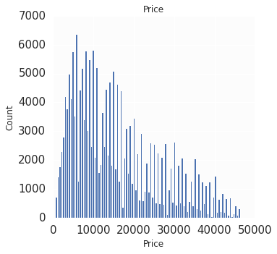
Feature Scaling: Normalization
Normalization is the best choice for this context because we know that the distribution of data does not follow a Gaussian distribution.

Slide 26
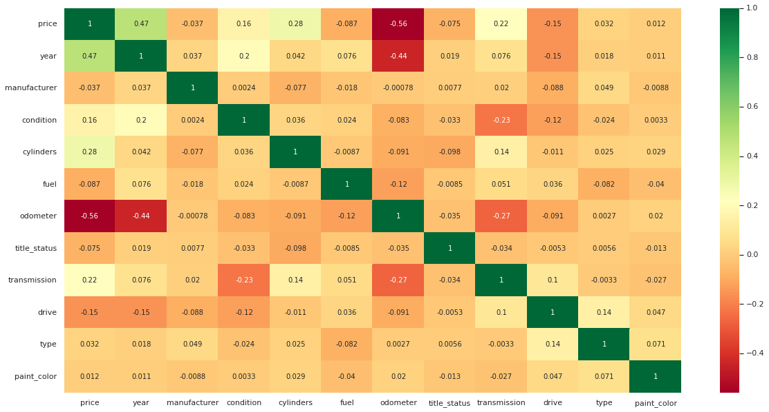
Feature Selection Since all features somehow correlates to price, selecting all features for now. We will use ensemble techniques to find the best features later.

Slide 27
Splitting dataset into Training and Testing Set
Training Set: 80%
Testing Set: 20%

Slide 28
Fitting Machine Learning Algorithms
Linear Regression
KNN Regressor
Decision Tree Regressor
Random Forest Regressor
XgBoost Regressor
AdaBoost Regressor

Slide 29
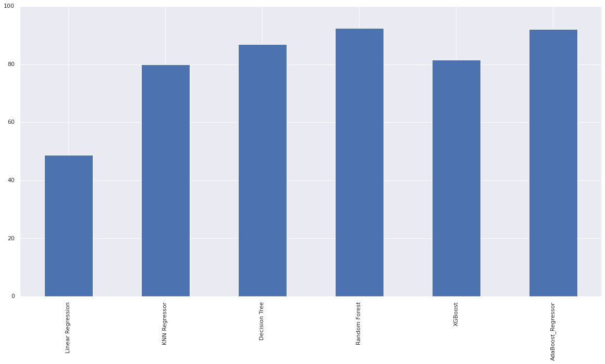
ML Algorithms: R2 Scores

Slide 30
ML Algorithms: R2 Scores
ML Algorithms | R2 Score
Linear Regression | 48.84
KNN Regressor | 79.88
Decision Tree Regressor | 86.91
Random Forest Regressor | 92.57
XgBoost Regressor | 81.59
AbaBoost Regressor | 92.20

Slide 31
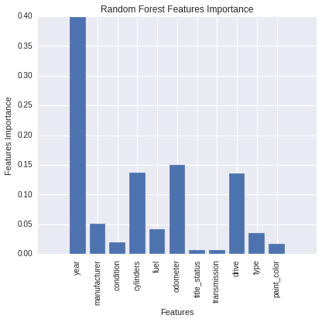
Feature Importance: Random Forest

Slide 32
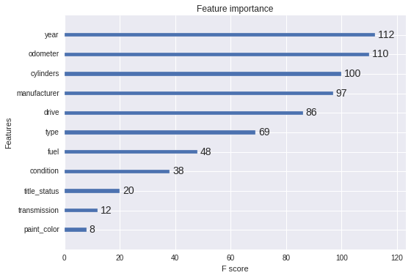
Feature Importance: XgBoost

Slide 33
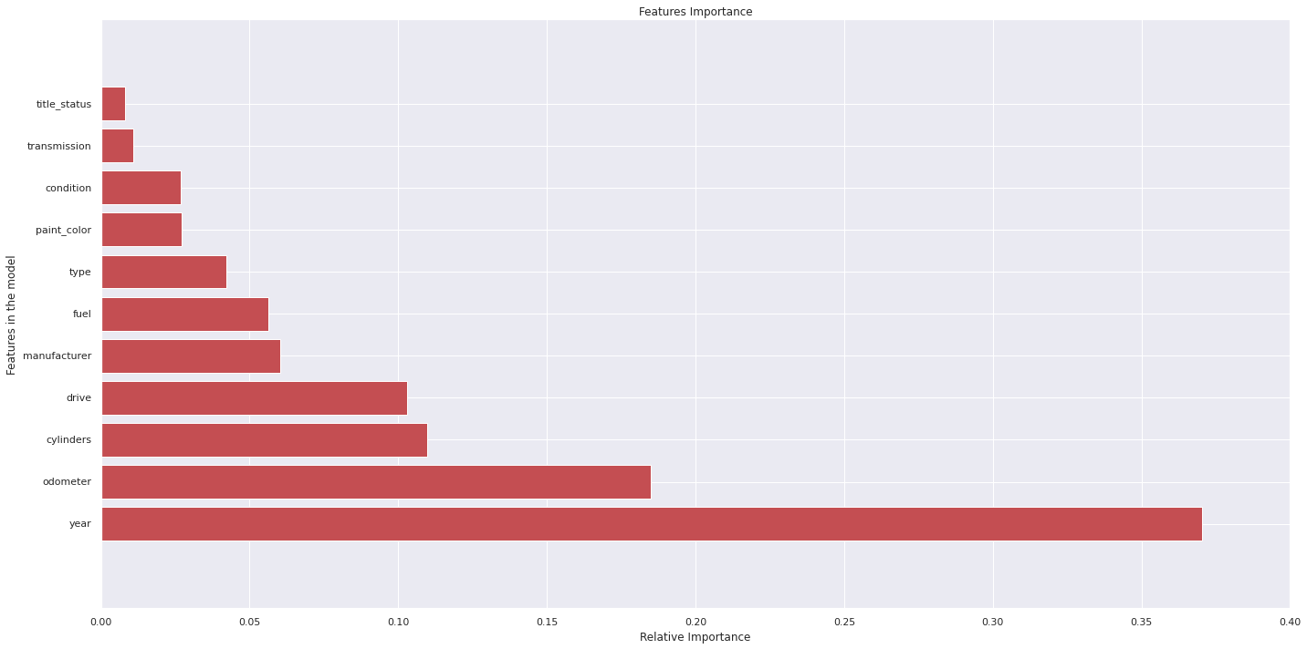
Feature Importance: AdaBoost

Slide 34
Hyper Parameter Tuning : AdaBoost Regressor
AdaBoost Regressor Base Mode R2 Score: 92.20
AdaBoost Regressor hyper parameter tuned model R2 score: 92.84

Slide 35
Limitations and Future Improvements
There was a relatively small dataset for making a strong inference for the prediction models because number of observations was only 458,213. Gathering more data can yield more robust predictions.
There were so many missing values in many features in the dataset. Handling those missing values more efficiently would result in robust models.
There are other many features that can be good predictors for the prediction of used cars. For example, number of doors, mileage(per gallon), ownership and vehicle history, insurance, and warranty. The good data related to these features could be collected for building better prediction models.

Slide 36
References
http://cs229.stanford.edu/proj2019aut/data/assignment_308832_raw/26612934.pdf
https://www.kaggle.com/msagmj/data-cleaning-eda-used-cars-prediction-86#Split-Train-and-Test-data
https://d2908q01vomqb2.cloudfront.net/f1f836cb4ea6efb2a0b1b99f41ad8b103eff4b59/2018/05/01/Pinpoint1.png
Rosenbaum, Eric. “The Used Car Boom Is One of the Hottest, and Trickiest, Coronavirus Markets for Consumers.” CNBC, CNBC, 16 Oct. 2020,www.cnbc.com/2020/10/15/used-car-boom-is-oneof-hottest-coronavirus-markets-for-consumers.html.
Gokce, Enes. “Predicting Used Car Prices with Machine Learning Techniques.” Medium, Towards Data Science, 10 Jan. 2020, towardsdatascience.com/predicting-used-car-prices-with-machine-learning-techniques-8a9d8313952.

